Slide 1
NGS: Downstream Analysis & Processing

Slide 2
The Plan…
Downstream analysis
Downstream processing
Gene sets
Transcriptome studies
Cistrome / Epigenome studies
Function enrichment
GSEA, DAVID, IPA
STRING, Cytoscape
Genome coordinate sets
NGS alignment files (reads/tags)
ChIP-Seq peaks
BEDTools
Galaxy
UCSC Table browser

Slide 3
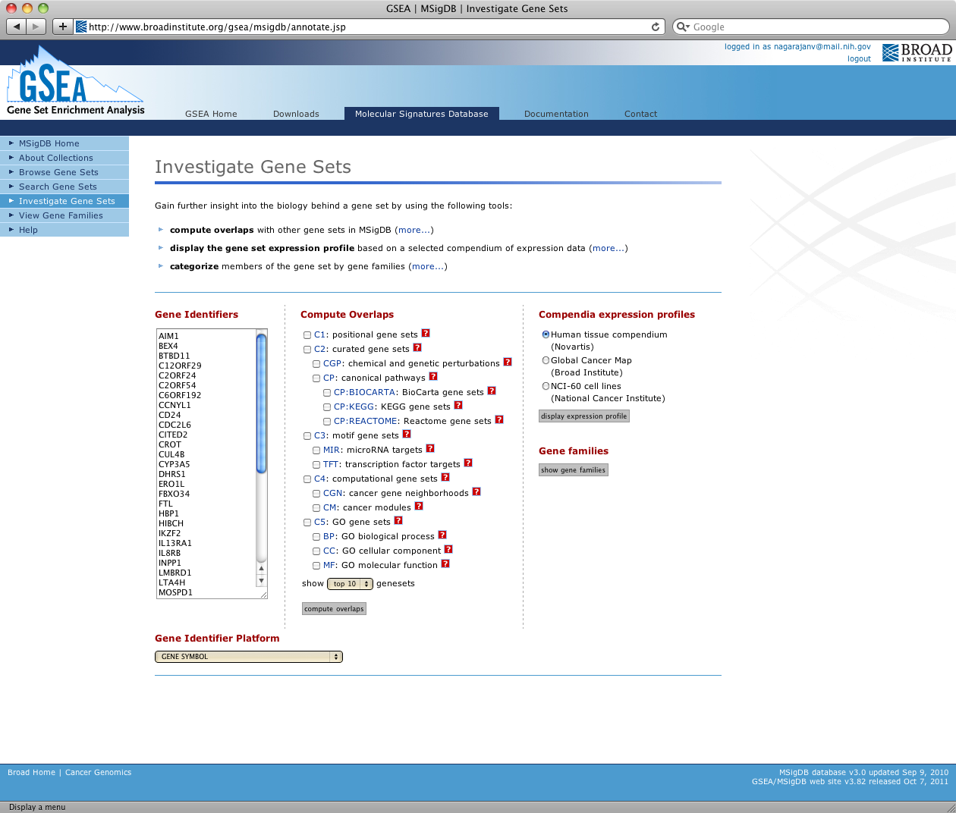
Gene Set Enrichment Analysis (GSEA) http://software.broadinstitute.org/gsea/index.jsp
Gene Set Enrichment Analysis (GSEA)
Broad Institute
“A computational method that determines whether an a priori defined set of genes shows statistically significant, concordant differences between two biological states”
Download the GSEA software and additional resources to analyze, annotate and interpret enrichment results.
Explore the Molecular Signatures Database (MSigDB), a collection of annotated gene sets for use with GSEA software.

Slide 4
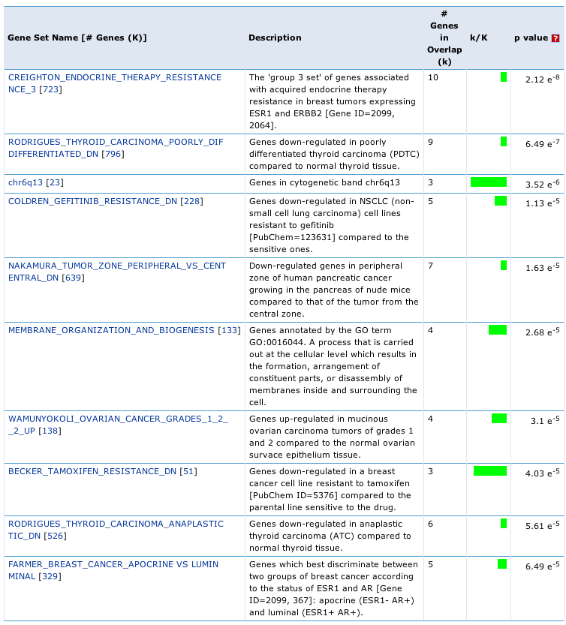
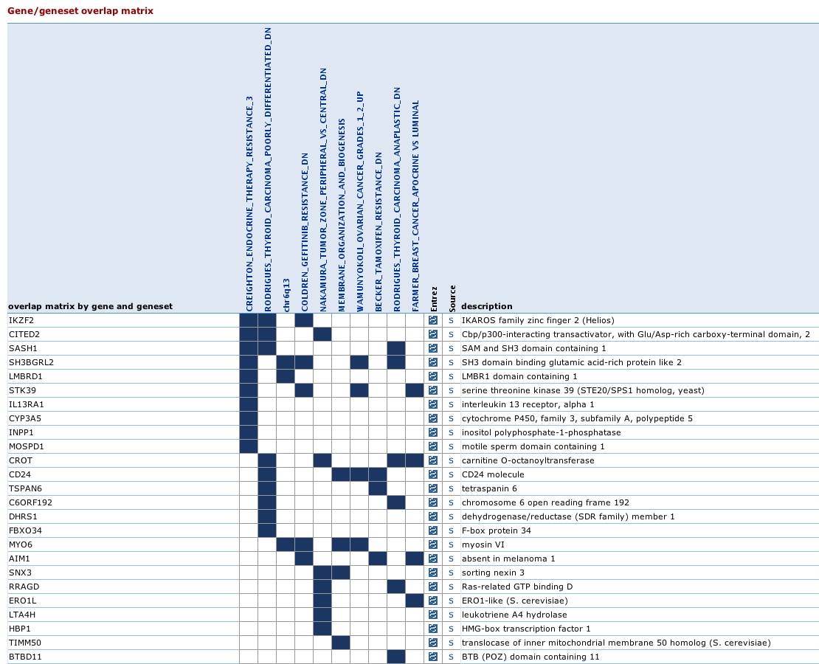
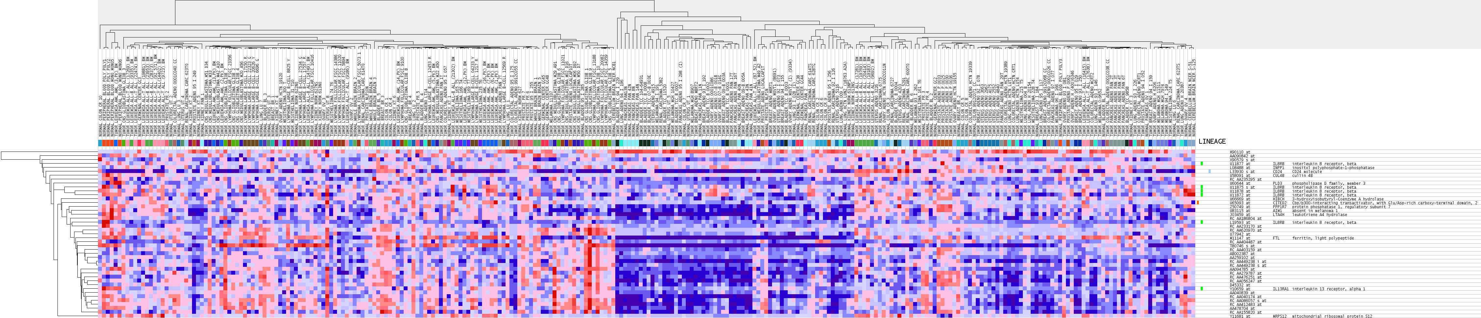
Gene Set Enrichment Analysis (GSEA) http://software.broadinstitute.org/gsea/index.jsp

Slide 5
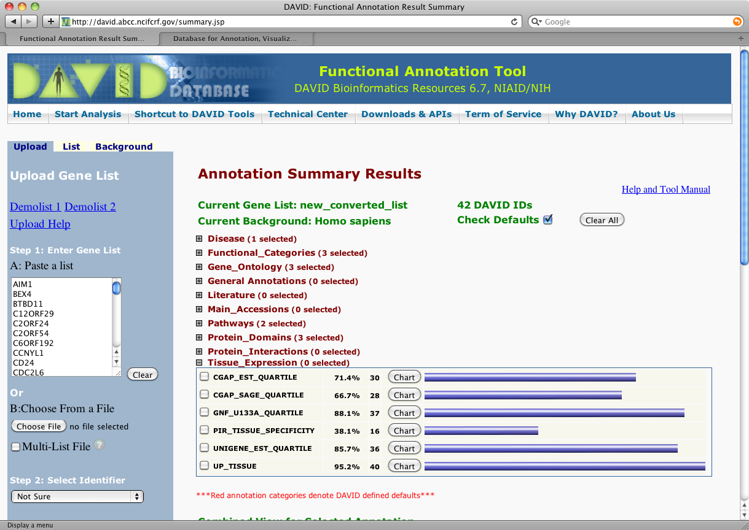
Database for Annotation, Visualization and Integrated Discovery (DAVID) https://david.ncifcrf.gov/
DAVID provides a comprehensive set of functional annotation tools for investigators to understand biological meaning behind large list of genes.
For any given gene list, DAVID tools are able to:
Identify enriched biological themes, particularly GO terms
Discover enriched functional-related gene groups
Cluster redundant annotation terms
Visualize genes on BioCarta & KEGG pathway maps
Display related many-genes-to-many-terms on 2-D view.
Search for other functionally related genes not in the list
Notes:
The Database for Annotation, Visualization andIntegrated Discovery (DAVID ) v6.8 comprises a full Knowledgebase update to the sixth version of our original web-accessible programs. DAVID now provides a comprehensive set of functional annotation tools for investigators to understand biological meaning behind large list of genes. For any given gene list, DAVID tools are able to: Identify enriched biological themes, particularly GO terms Discover enriched functional-related gene groups Cluster redundant annotation terms Visualize genes on BioCarta & KEGG pathway maps Display related many-genes-to-many-terms on 2-D view. Search for other functionally related genes not in the list List interacting proteins Explore gene names in batch Link gene-disease associations Highlight protein functional domains and motifs Redirect to related literatures Convert gene identifiers from one type to another. And more

Slide 6
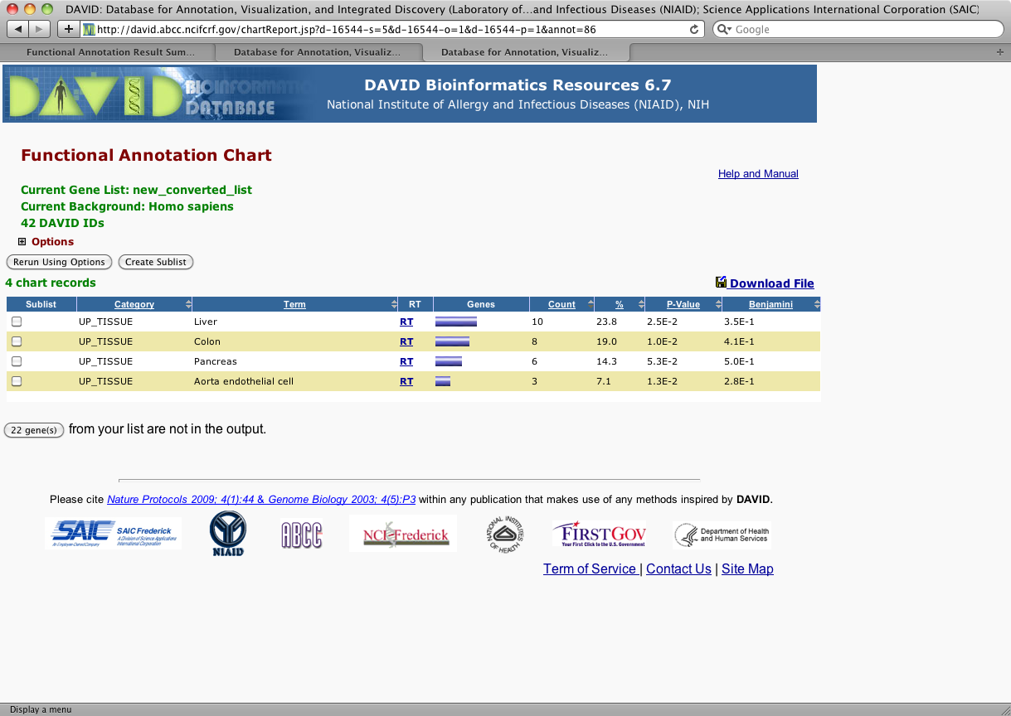
Database for Annotation, Visualization and Integrated Discovery (DAVID) https://david.ncifcrf.gov/
Cont.
List interacting proteins
Explore gene names in batch
Link gene-disease associations
Highlight protein functional domains and motifs
Redirect to related literatures
Convert gene identifiers from one type to another.

Slide 7
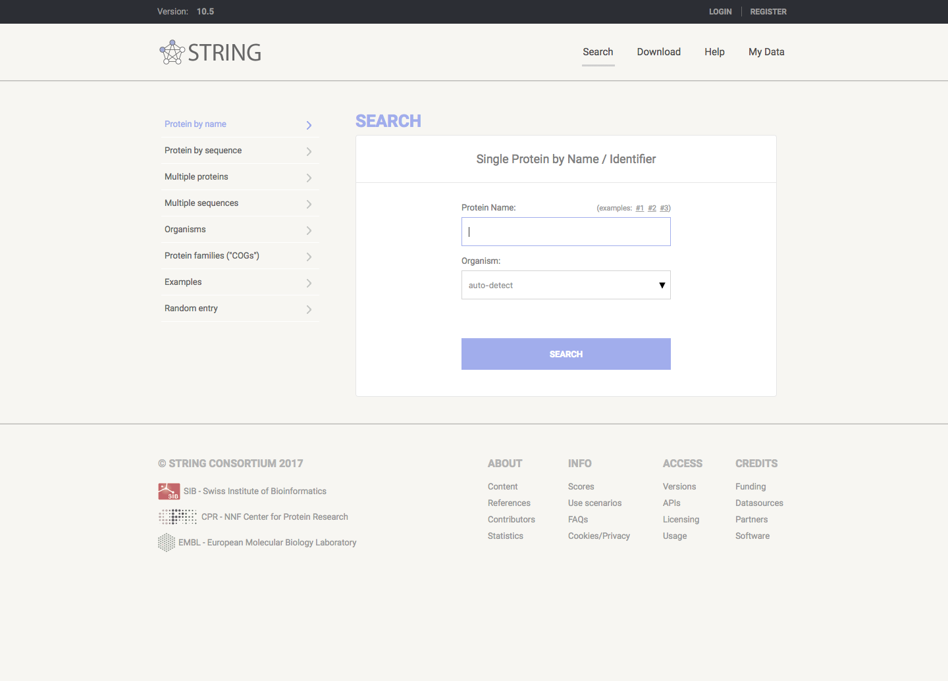
Search Tool for the Retrieval of Interacting Genes/Proteins (STRING) https://string-db.org
STRING (Search Tool for the Retrieval of Interacting Genes/Proteins) is a biological database and web resource of known and predicted protein–protein interactions.
Notes:
Protein-Protein Interaction Networks

Slide 8
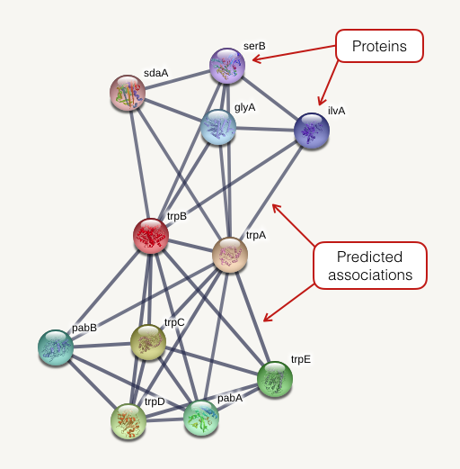
Search Tool for the Retrieval of Interacting Genes/Proteins (STRING) https://string-db.org
Notes:
Protein-Protein Interaction Networks

Slide 9
Cytoscape http://www.cytoscape.org/
Software
Cytoscape is an open source software platform for visualizing molecular interaction networks and biological pathways and integrating these networks with annotations, gene expression profiles and other state data.

Slide 10
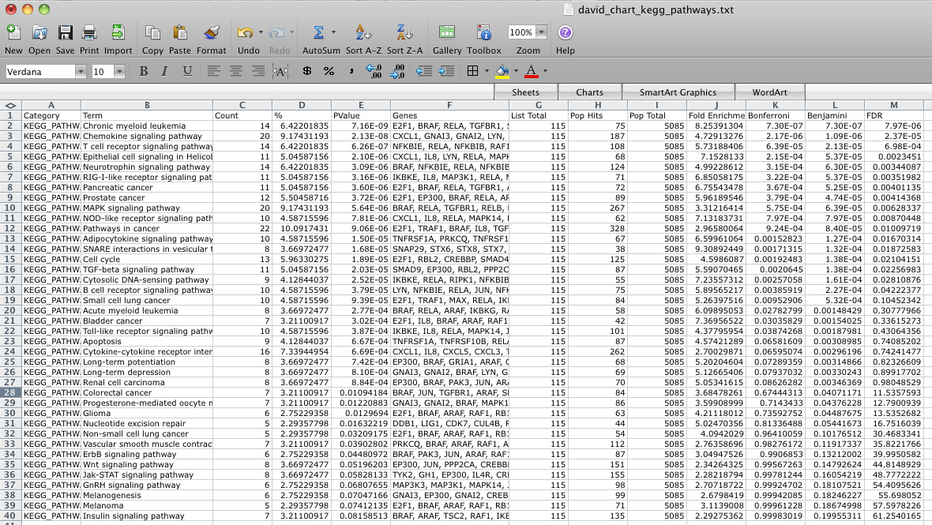
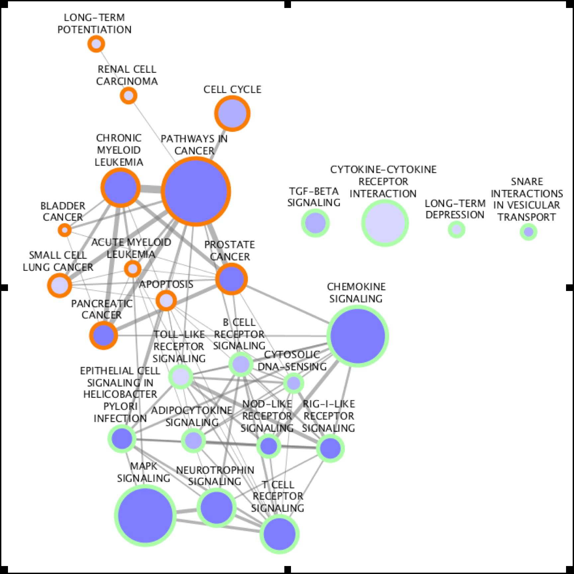
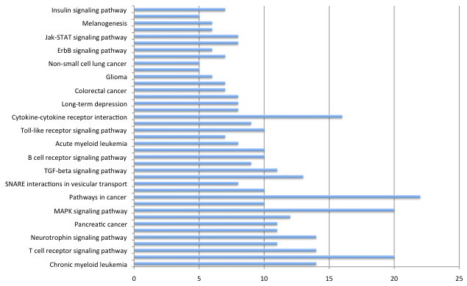
Cytoscape http://www.cytoscape.org/

Slide 11
BED-Tools http://bedtools.readthedocs.io/en/latest/
Command line
Open source
A variety of input formats (BED, BEDPE, SAM/BAM, GFF, VCF)
Things we could do…
Intersect, Union
Merge
Coverage
Subtract
Convert
Closest
Shuffle
Group, Sort

Slide 12
Commercial Tools

Slide 13
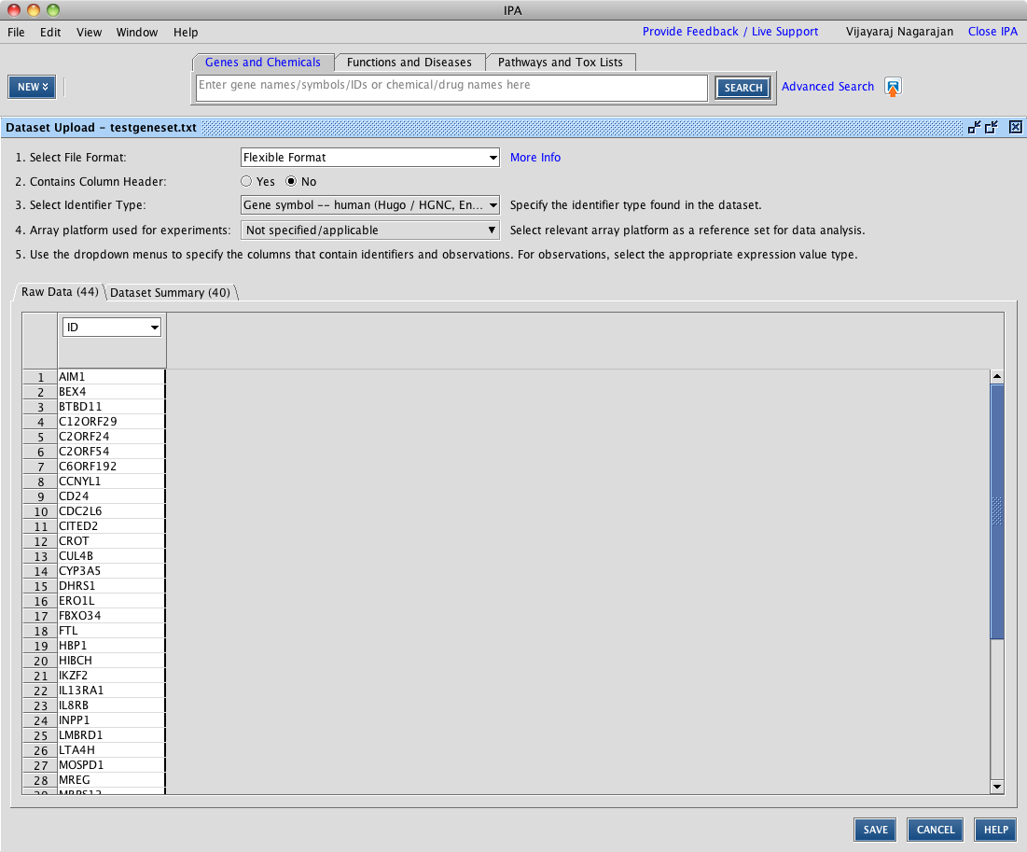
Ingenuity Pathway Analysis (IPA) https://www.qiagenbioinformatics.com/products/ingenuity-pathway-analysis/
Ingenuity Pathway Analysis is a powerful analysis and search tool that uncovers the significance of ‘omics data and identifies new targets or candidate biomarkers within the context of biological systems.
Canonical Pathway
Molecule Activity Predictor (MAP) Upstream Regulator Analysis
Mechanistic Networks
Downstream Effects Analysis
Regulator Effects
Network Analysis
…
Notes:
Ingenuity® Pathway Analysis (IPA®) is a powerful analysis and search tool that uncovers the significance of ‘omics data and identifies new targets or candidate biomarkers within the context of biological systems. IPA has broadly been adopted by the life science research community and is cited in thousands of articles for the analysis, integration, and interpretation of data derived from ‘omics experiments, such as RNA-seq, small RNA-seq, microarrays including miRNA and SNP, metabolomics, proteomics, and small scale experiments.
With it’s many features, IPA allows you to quickly understand and visualize your data.

Slide 14
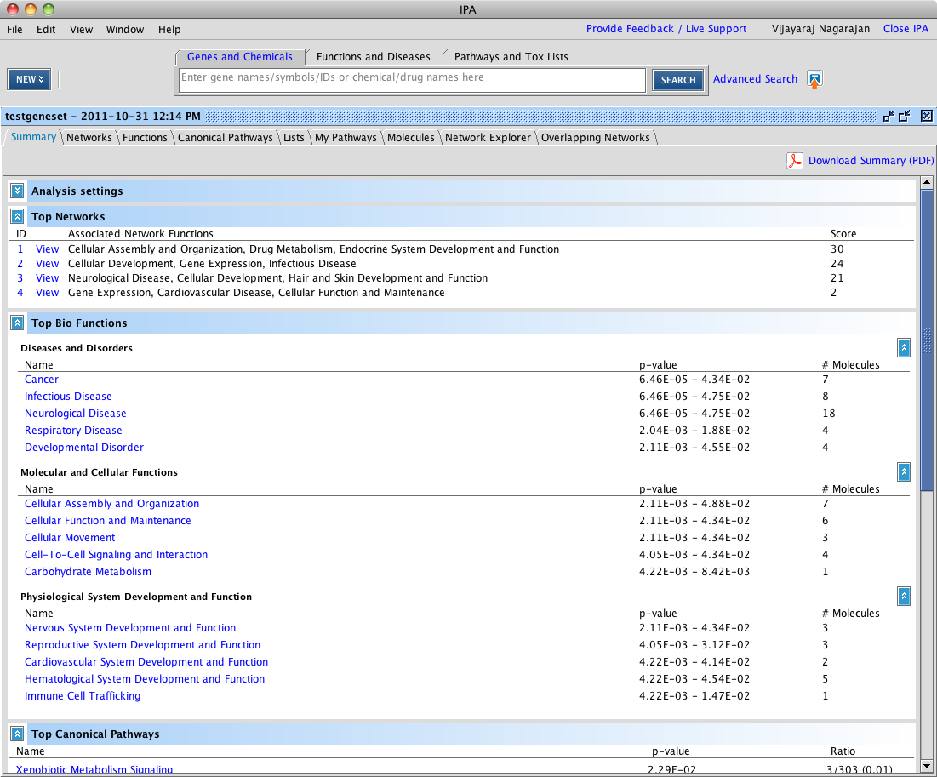
Ingenuity Pathway Analysis (IPA) https://www.qiagenbioinformatics.com/products/ingenuity-pathway-analysis/
Cont…
Comparison Analysis
MicroRNA Target Filter
Isoform View
Disease View
Tox Lists and Tox Functions
Gene and ChemView
Interactive Disease and Functions Nodes
Biomarker Filter
Path Designer

Slide 15
Additional Tools

Slide 16
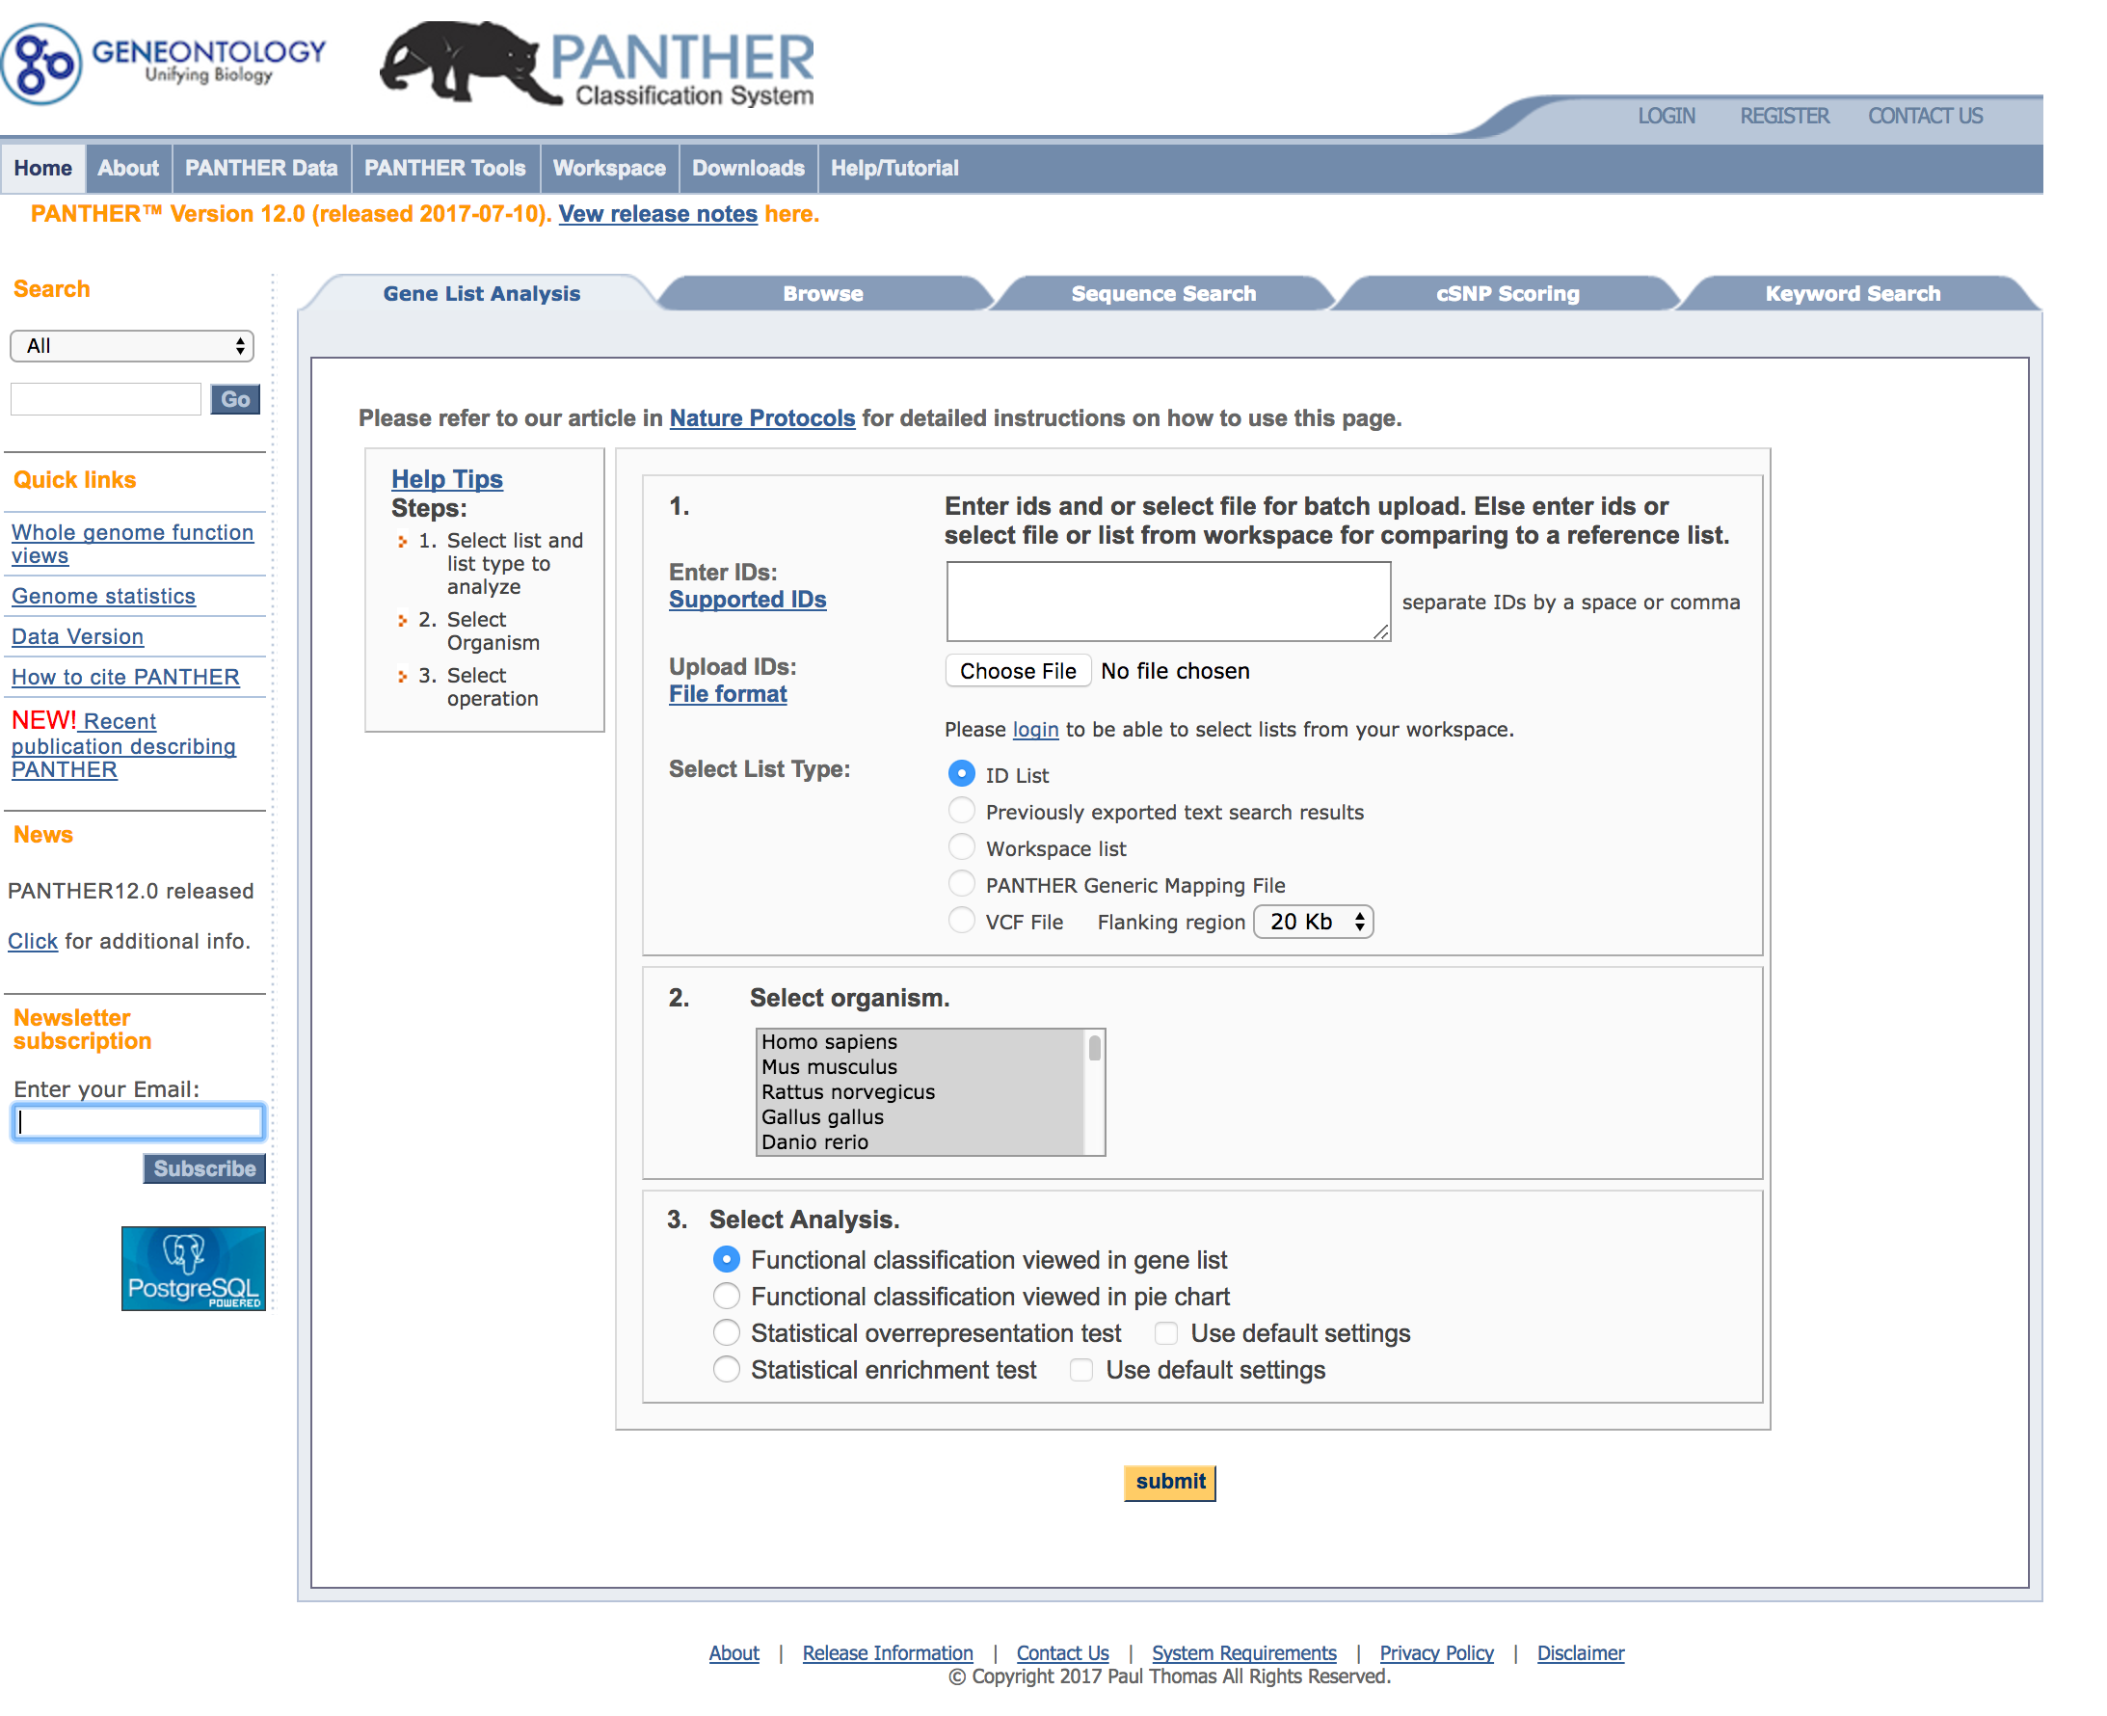
Panther http://www.pantherdb.org
Protein Analysis Through Evolutionary Relationships (PANTHER) Classification System
Classify proteins (and their genes) according to evolutionarily related proteins that have the same function, the function of the protein by itself or with directly interacting proteins at a biochemical level (e.g. a protein kinase), the function of the protein in the context of a larger network of proteins that interact to accomplish a process at the level of the cell or organism (e.g. mitosis), and the pathway that explicitly specifies the relationships between the interacting molecules.
Notes:
The PANTHER (Protein ANalysis THrough Evolutionary Relationships) Classification System was designed to classify proteins (and their genes) in order to facilitate high-throughput analysis. Proteins have been classified according to:Family and subfamily: families are groups of evolutionarily related proteins; subfamilies are related proteins that also have the same function
Molecular function: the function of the protein by itself or with directly interacting proteins at a biochemical level, e.g. a protein kinase
Biological process: the function of the protein in the context of a larger network of proteins that interact to accomplish a process at the level of the cell or organism, e.g. mitosis.
Pathway: similar to biological process, but a pathway also explicitly specifies the relationships between the interacting molecules.
The PANTHER Classifications are the result of human curation as well as sophisticated bioinformatics algorithms. Details of the methods can be found in (Mi et al. NAR 2013; Thomas et al., Genome Research 2003). For more information about the data on PANTHER and the relationships between data types, see the "PANTHER Data Overview" figure. PANTHER is part of the Gene Ontology Phylogenetic Annotation Project. PANTHER is supported by research grants from the National Human Genome Research Institute and the National Science Foundation, and maintained by the Thomas lab at the University of Southern California. Version 12.0 (released 2017-07-10) contains 14710 protein families, divided into 76032 functionally distinct protein subfamilies.

